Slide 1

ENGR-848 Digital VLSI Design
16 x 8 SRAM in 14nm CMOS Technology
UNDER THE GUIDANCE OF : Dr. HAMID MAHAMOODI
SPOORTHI YADAV MANJUNATH (924353765)
VYSHANVI SHEKHAR BYRAPATNA SOMASHEKHAR (923840668)
SEYEDPARSA MIRFASIHI(923636204)
DEPARTMENT OF ELECTRICAL AND COMPUTER ENGINEERING SPRING - 2025

Slide 2
OUTLINE
Design Specifications
Modules
SRAM and SRAM array
Decoder
Pre-charge
Sense amplifier
Write driver
Timing circuit
Top level
Functional verification
Performance characterization (area, standby power, read access time)
What we have learned

Slide 3
DESIGN CONSTRAINTS
1. Bus Specifications
Address Bus Width: 4 bits
Input Data Bus Width: 8 bits
Output Data Bus Width: 8 bits
2. Electrical Constraints
(All electrical constraints are specified at a nominal supply voltage of 0.8 V and a worst-case temperature of 110°C.)
Minimum Read Static Noise Margin (SNM): ≥ 150 mV
Minimum Bit-Line Differential (Read Mode): ≥ 100 mV
Measured when the sense amplifier is enabled.
Maximum Standby Power Consumption: ≤ 100 μW
3. Design Goal
minimize chip area, access time, active power, or the product of all

Slide 4
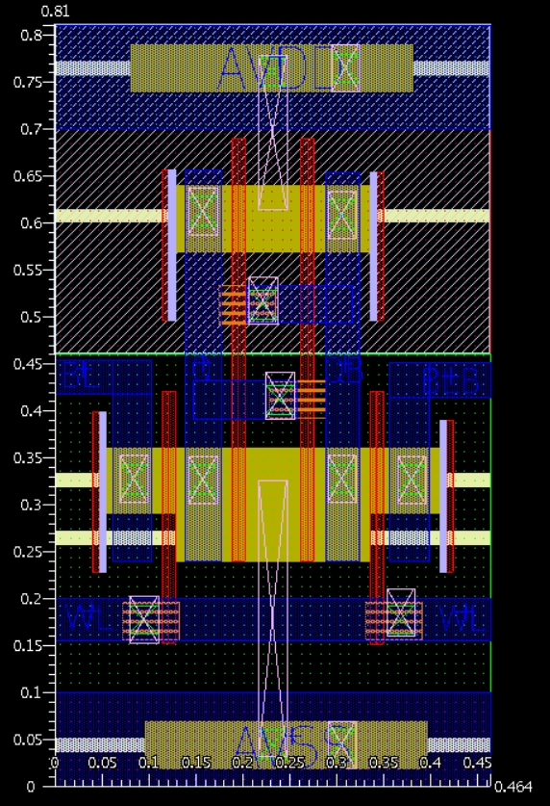
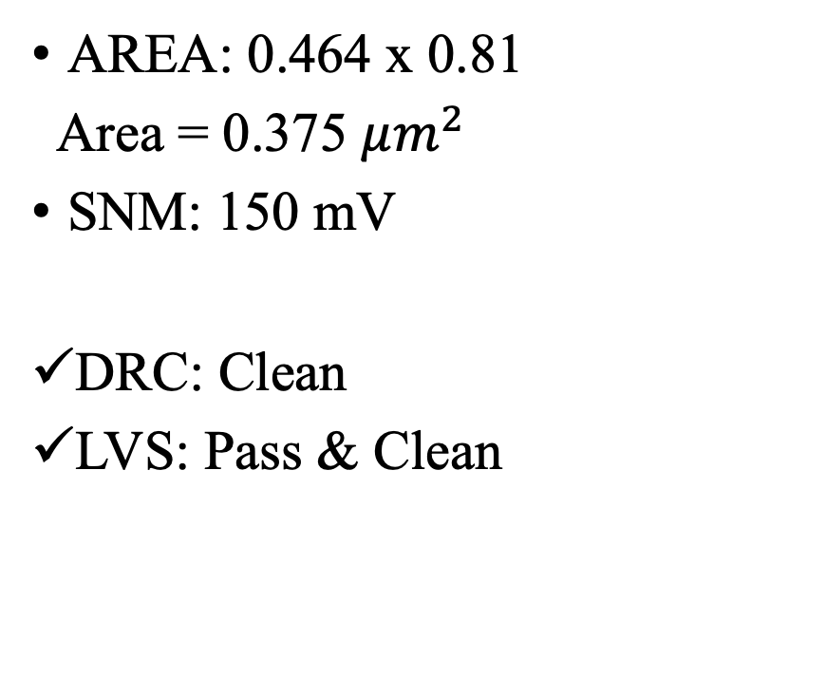
SRAM
AREA: 0.464 x 0.81
Area = 0.375 $μm^{2}$
SNM: 150 mV
DRC: Clean
LVS: Pass & Clean

Slide 5
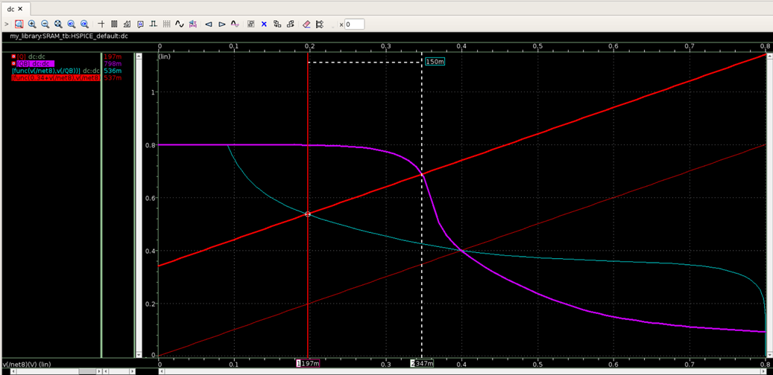
SNM = 150mV

Slide 6
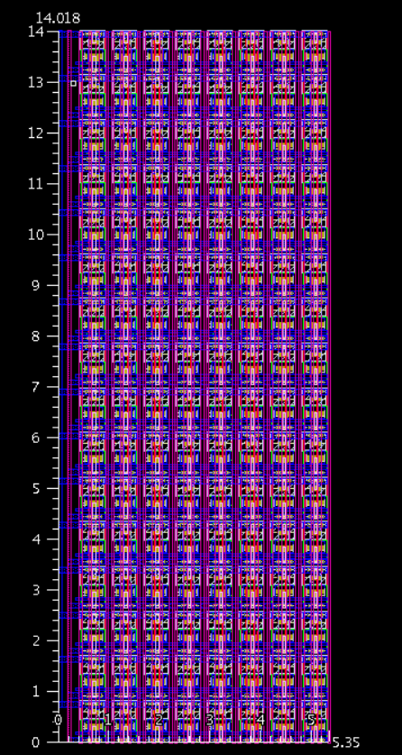
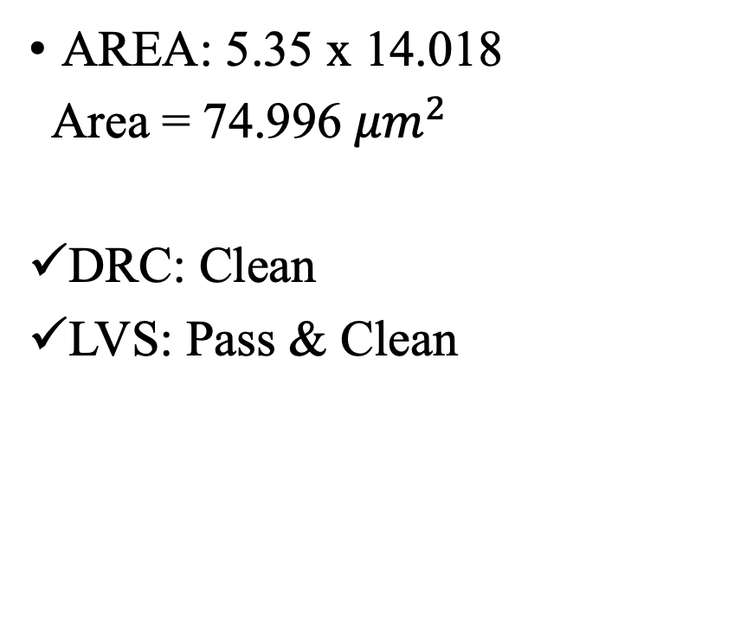
SRAM ARRAY
AREA: 5.35 x 14.018
Area = 74.996 ${μm}^{2}$
DRC: Clean
LVS: Pass & Clean

Slide 7
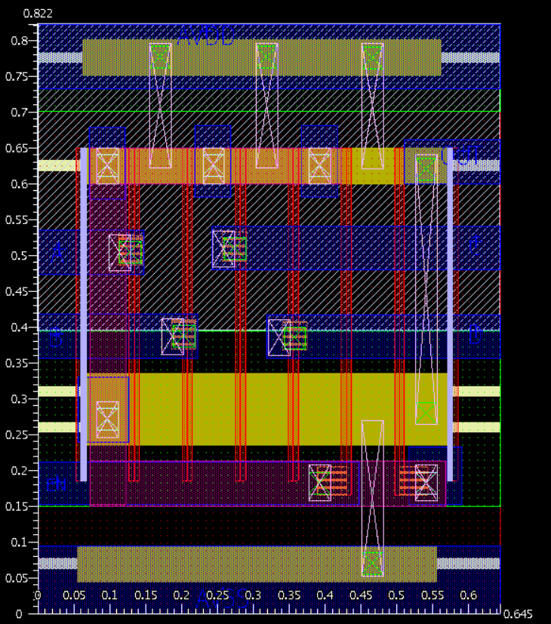
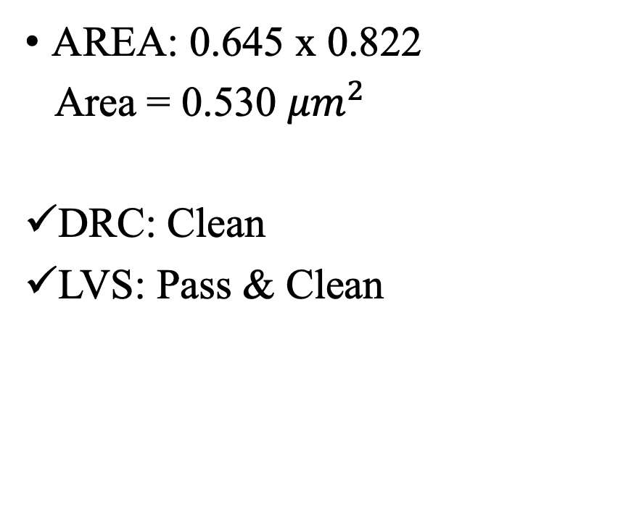
AND
AREA: 0.645 x 0.822
Area = 0.530 ${μm}^{2}$
DRC: Clean
LVS: Pass & Clean

Slide 8
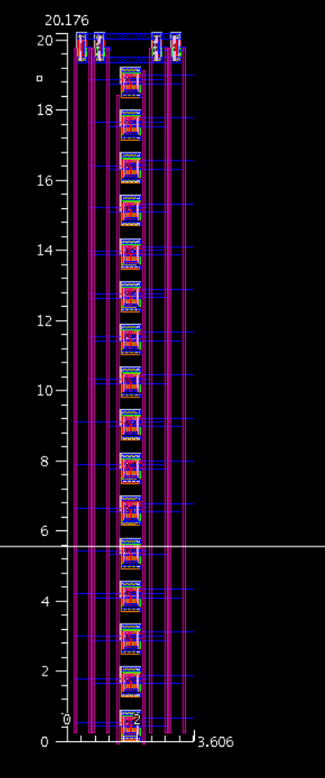
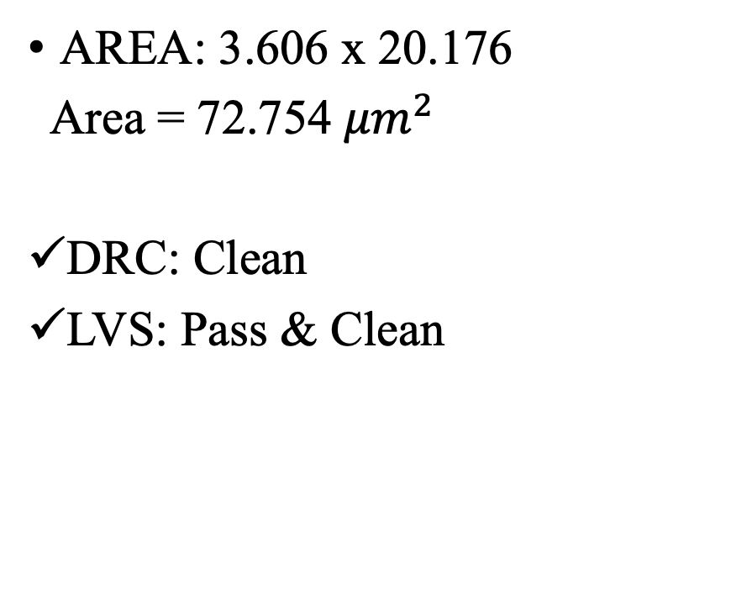
DECODER
AREA: 3.606 x 20.176
Area = 72.754 ${μm}^{2}$
DRC: Clean
LVS: Pass & Clean

Slide 9
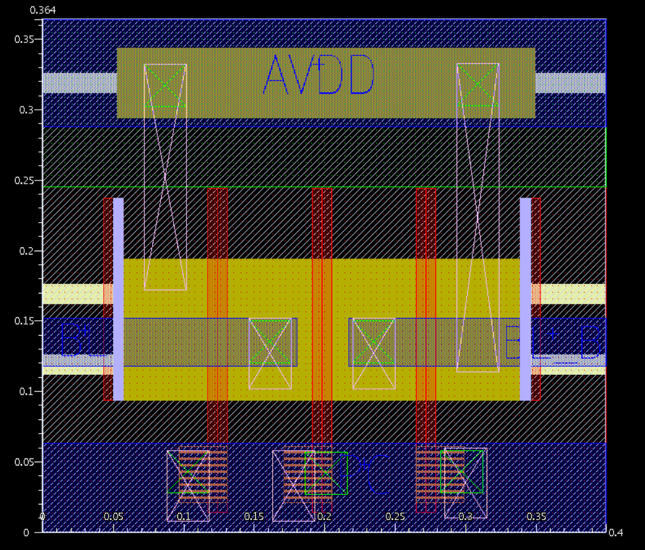
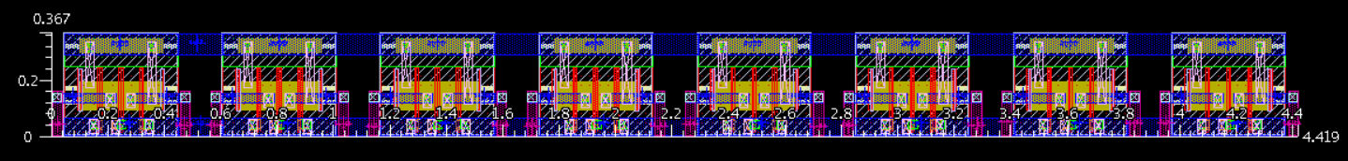
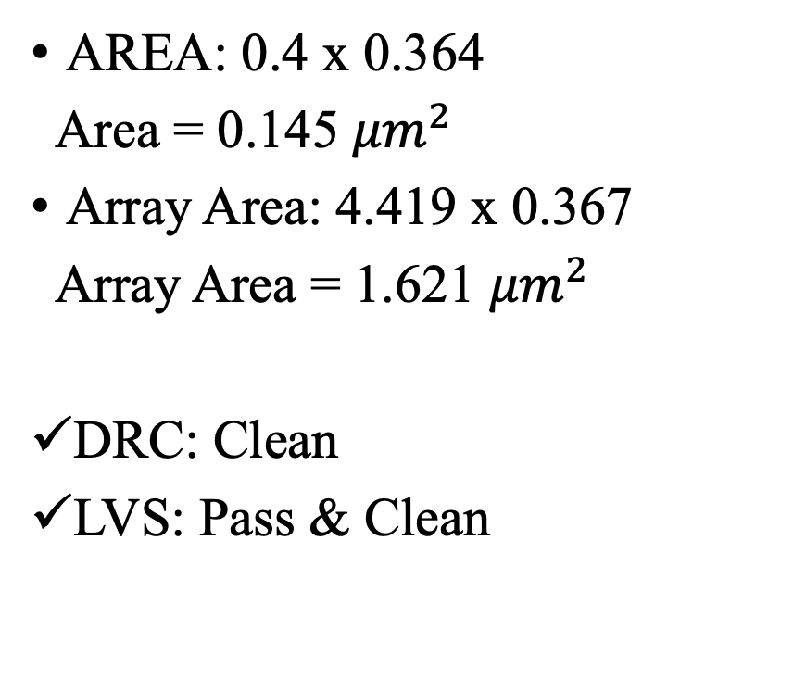
PRECHARGE
AREA: 0.4 x 0.364
Area = 0.145 ${μm}^{2}$
Array Area: 4.419 x 0.367
Array Area = 1.621 ${μm}^{2}$
DRC: Clean
LVS: Pass & Clean
Precharge Array

Slide 10
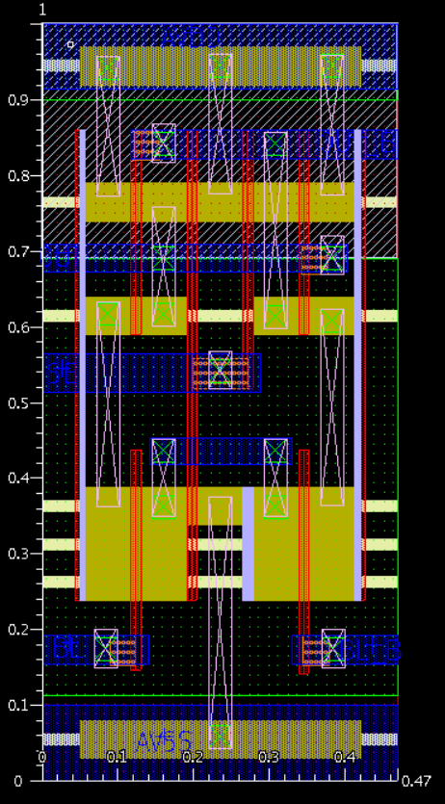
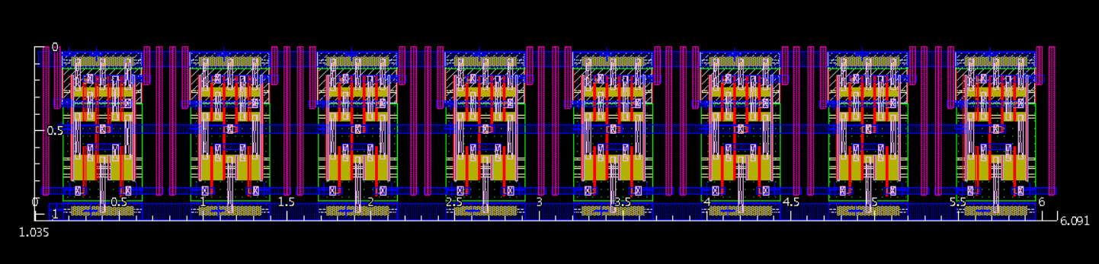
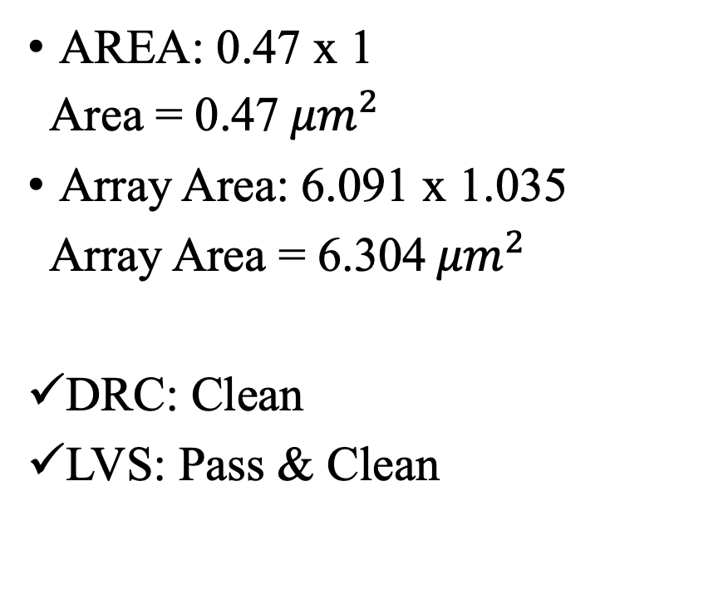
SENSE AMPLIFIER
AREA: 0.47 x 1
Area = 0.47 ${μm}^{2}$
Array Area: 6.091 x 1.035
Array Area = 6.304 ${μm}^{2}$
DRC: Clean
LVS: Pass & Clean

Slide 11
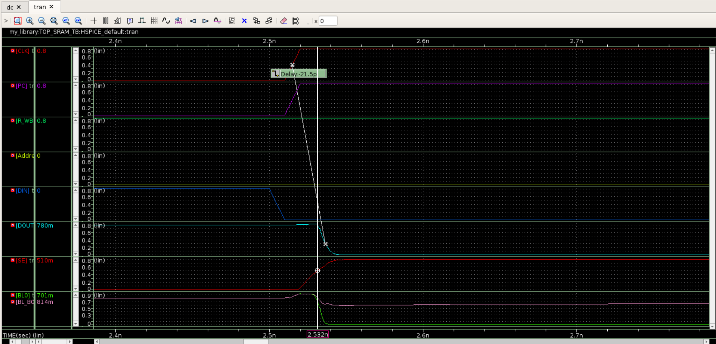
BL & BL_B DIFF is 113mV

Slide 12
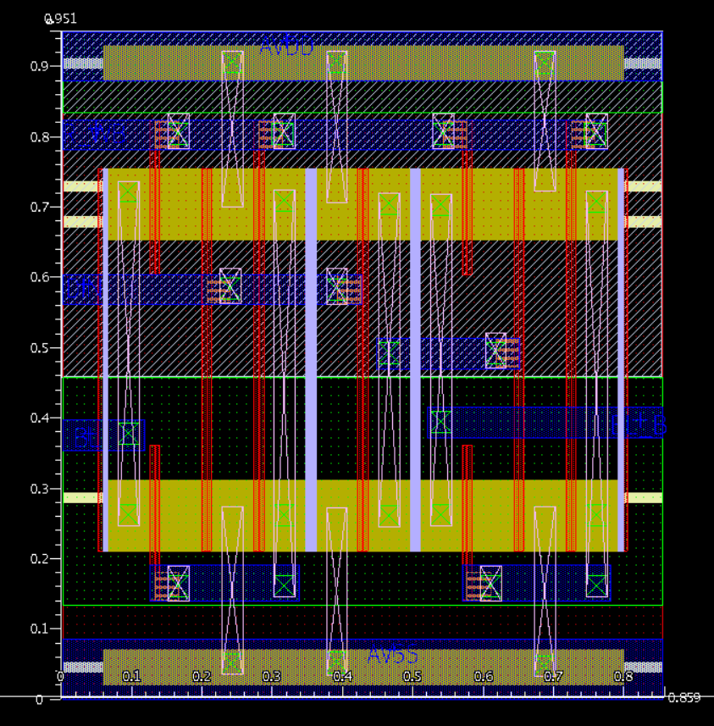
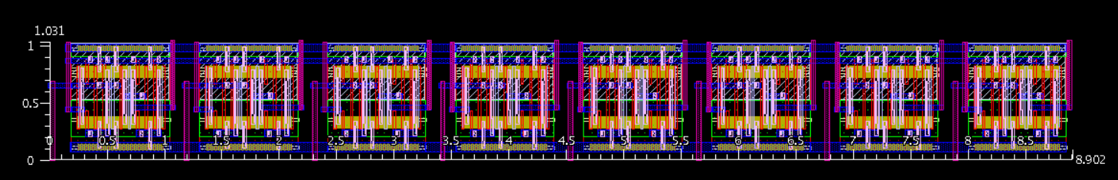
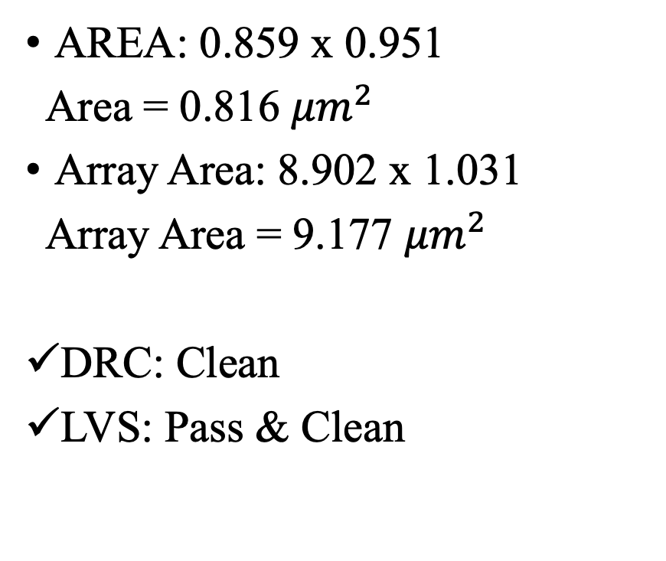
WRITE DRIVER
AREA: 0.859 x 0.951
Area = 0.816 ${μm}^{2}$
Array Area: 8.902 x 1.031
Array Area = 9.177 ${μm}^{2}$
DRC: Clean
LVS: Pass & Clean
Write Driver Array

Slide 13
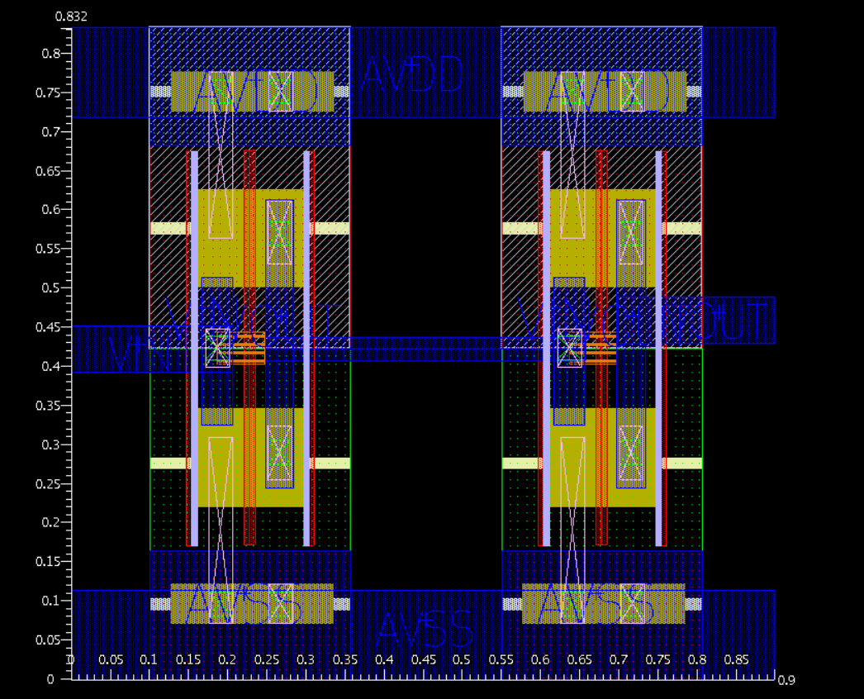
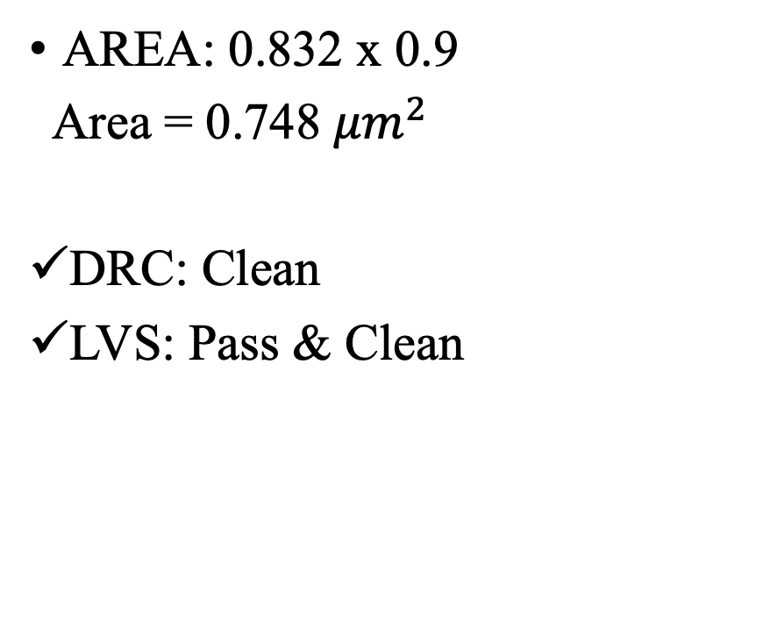
Timing Circuit
AREA: 0.832 x 0.9
Area = 0.748 ${μm}^{2}$
DRC: Clean
LVS: Pass & Clean

Slide 14
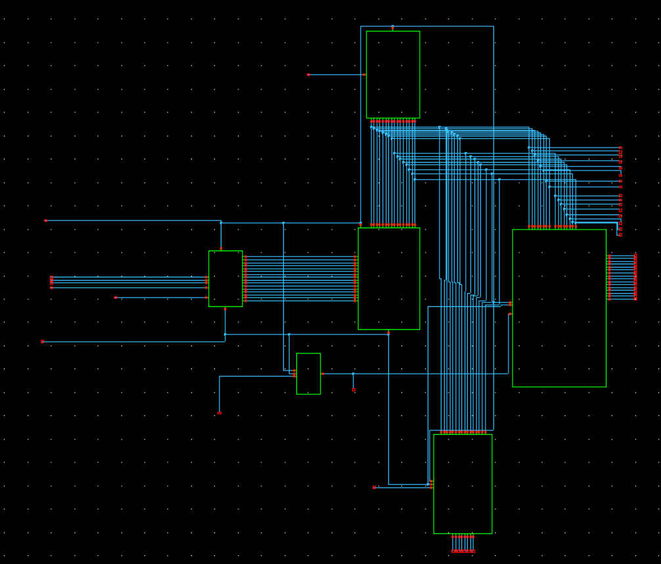
TOP LEVEL SCHEMATIC
Pre-charge
Decoder
SRAM Array
Sense Amplifier
Timing Circuit
Write Driver

Slide 15
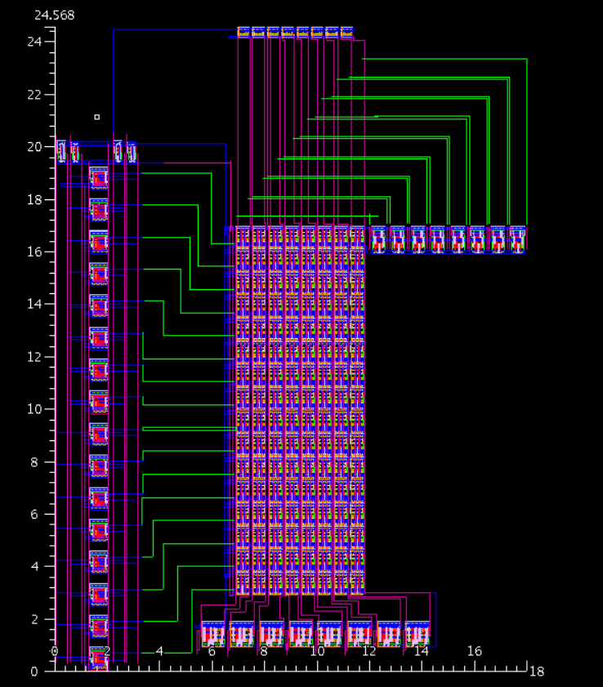
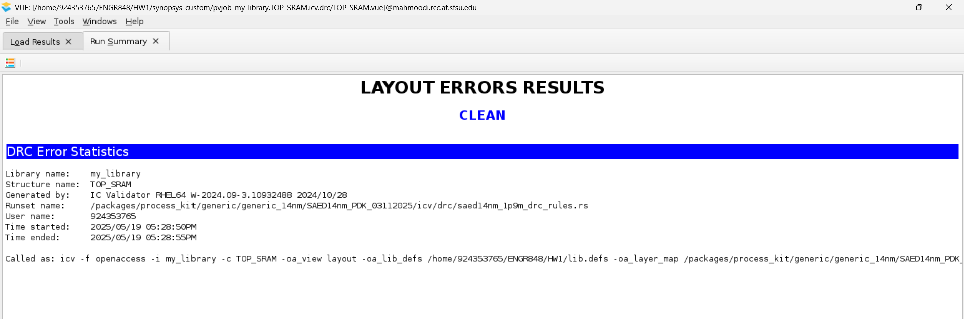
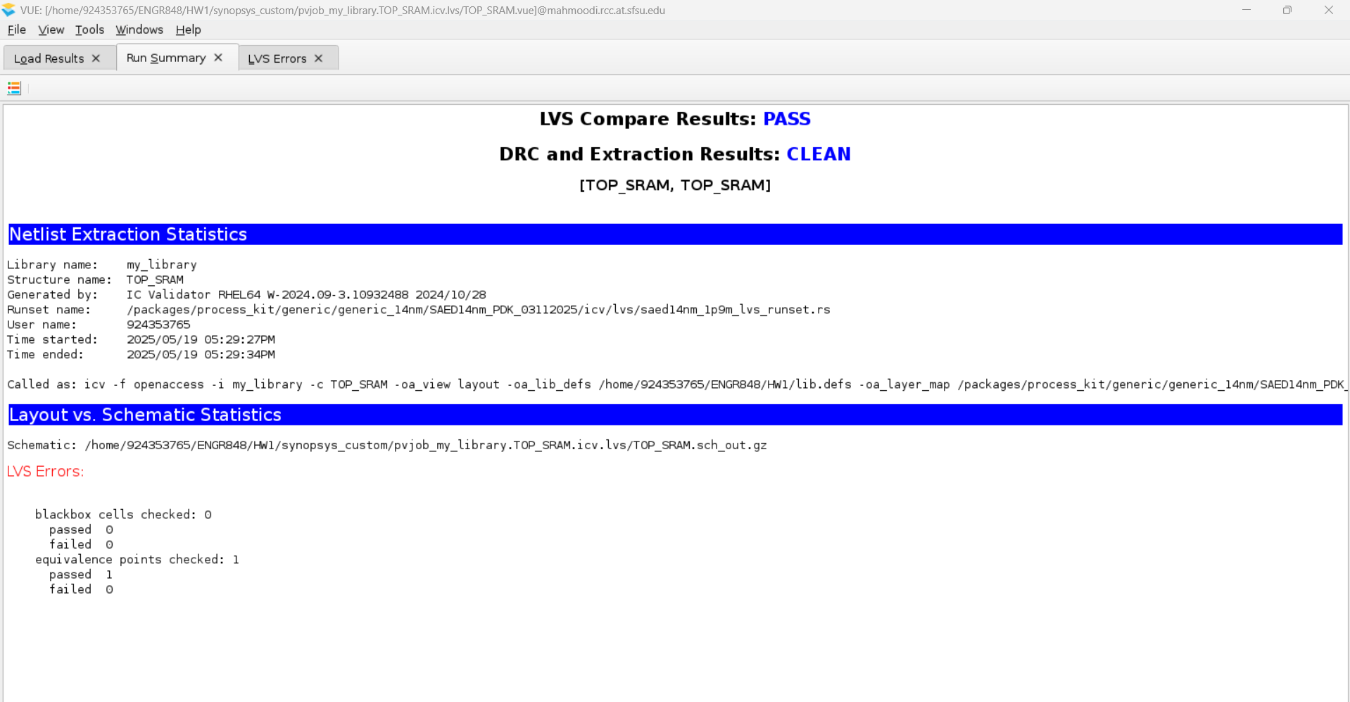
Top level complete 16 x 8 SRAM Array – Arear = 442.224 ${μm}^{2}$

Slide 16
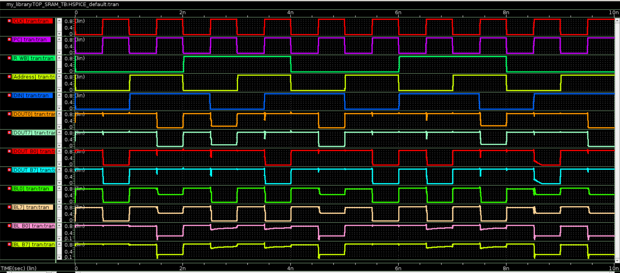
FUNCTIONAL VERIFICATION PRE-LAYOUT
PC SE PC SE PC SE PC SE PC SE PC SE PC SE PC SE
WRITE
READ
WRITE
READ
0 15
0 15
0 15
0 15
0 1
0 1
0 1
0 1
0
1
1
0
0
1
1
0
0 BL > BL_B
1 BL < BL_B

Slide 17
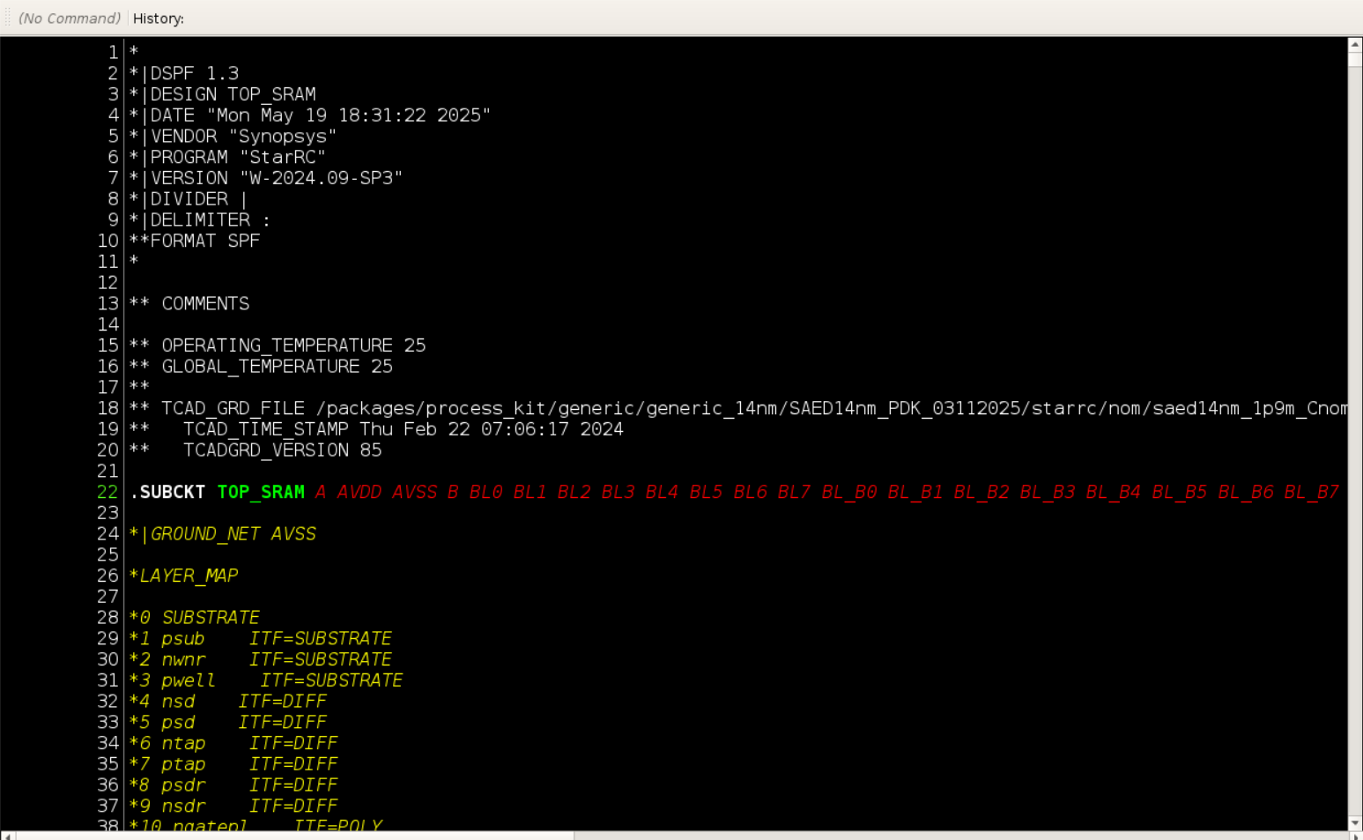
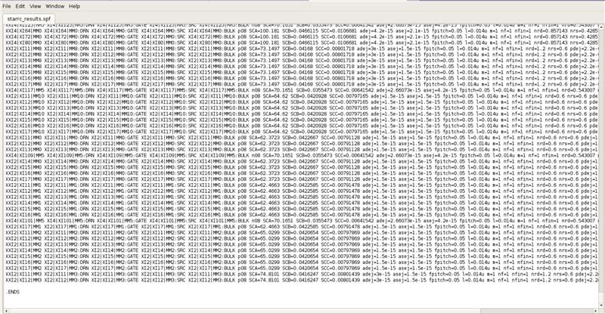
NETLIST AND PRACITIC EXTRACTION
PC SE PC SE PC SE PC SE PC SE PC SE PC SE PC SE
WRITE
READ
WRITE
READ
0 15
0 15
0 15
0 15
0 1
0 1
0 1
0 1
0
1
1
0
0
1
1
0
0 BL > BL_B
1 BL < BL_B

Slide 18
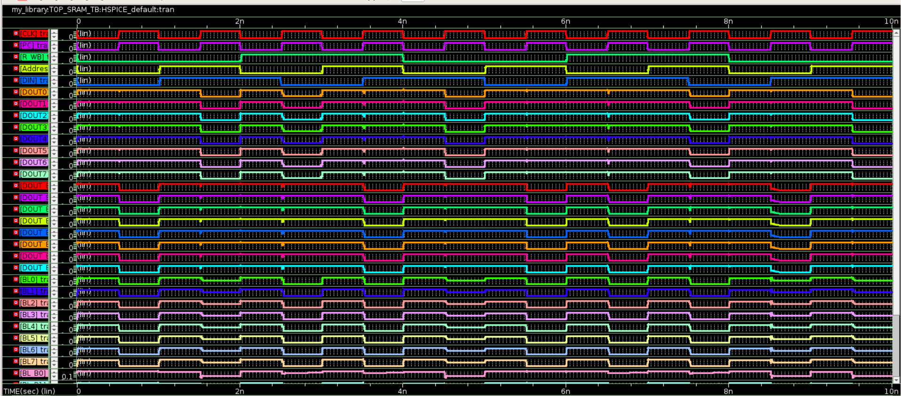
FUNCTIONAL VERIFICATION POST-LAYOUT

Slide 19
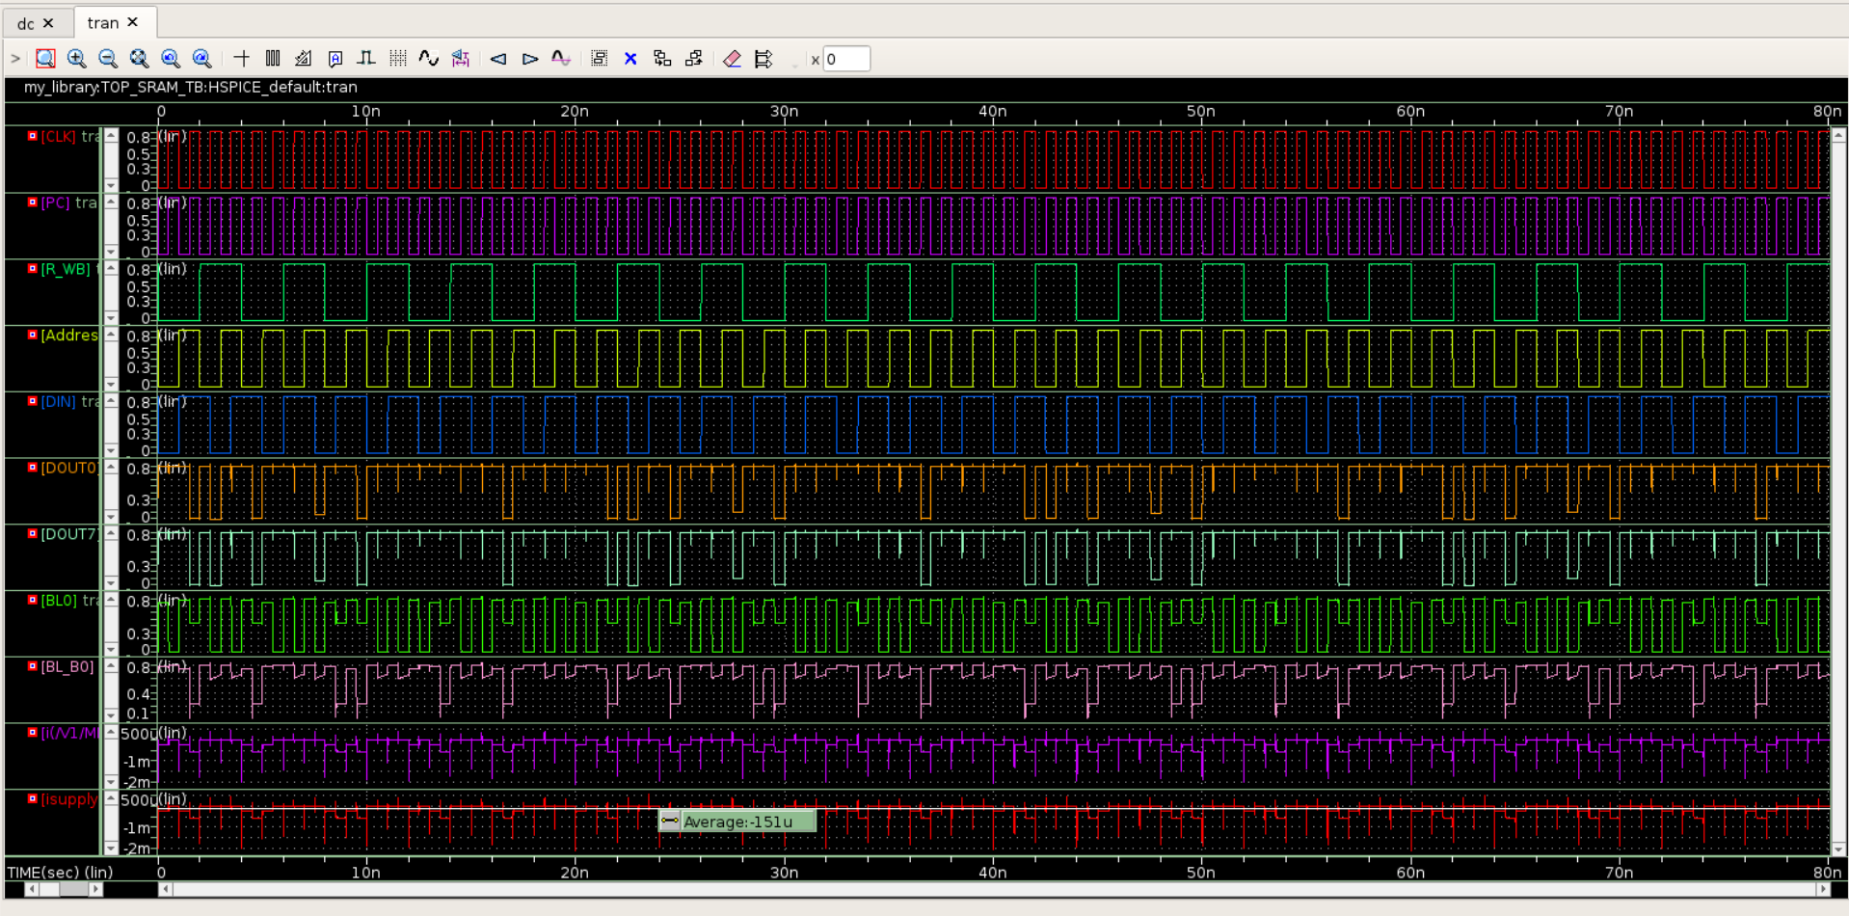
PRE-LAYOUT ACTIVE POWER
Active Power = Avg.Current x Voltage = 151 $μ$A x 0.8 V = 120.8 $μ$W

Slide 20
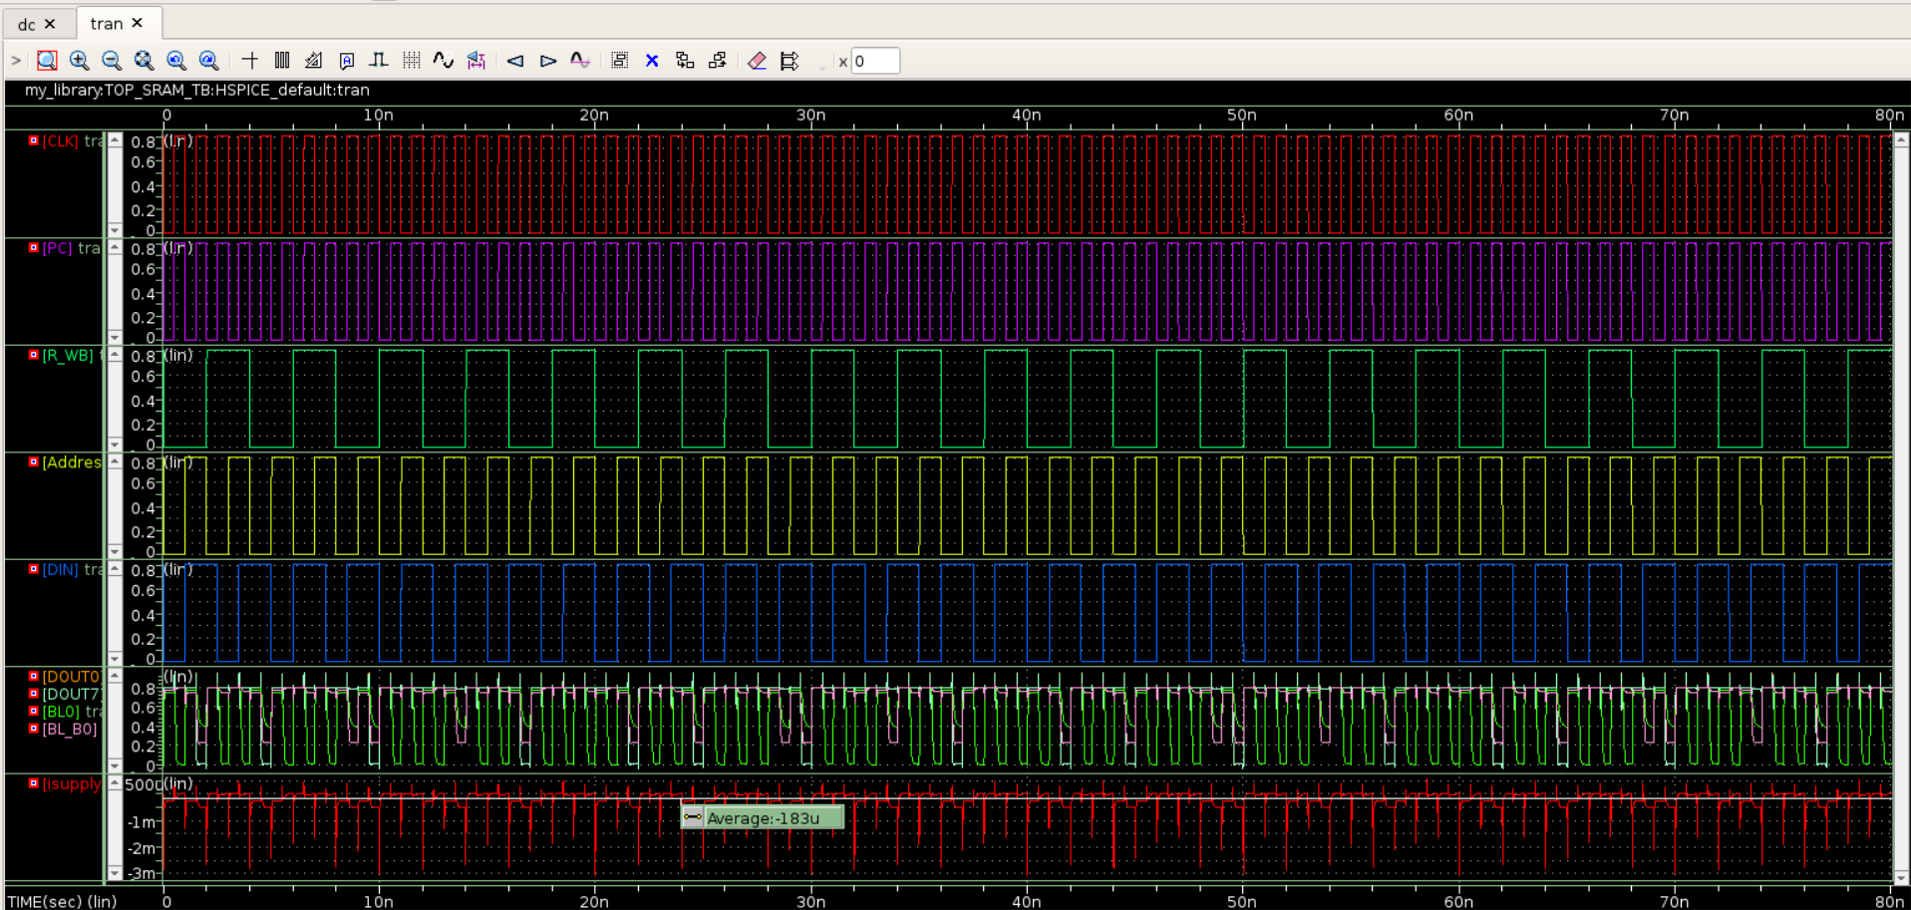
POST-LAYOUT ACTIVE POWER
Active Power = Avg.Current x Voltage = 183 $μ$A x 0.8 V = 146.4 $μ$W

Slide 21
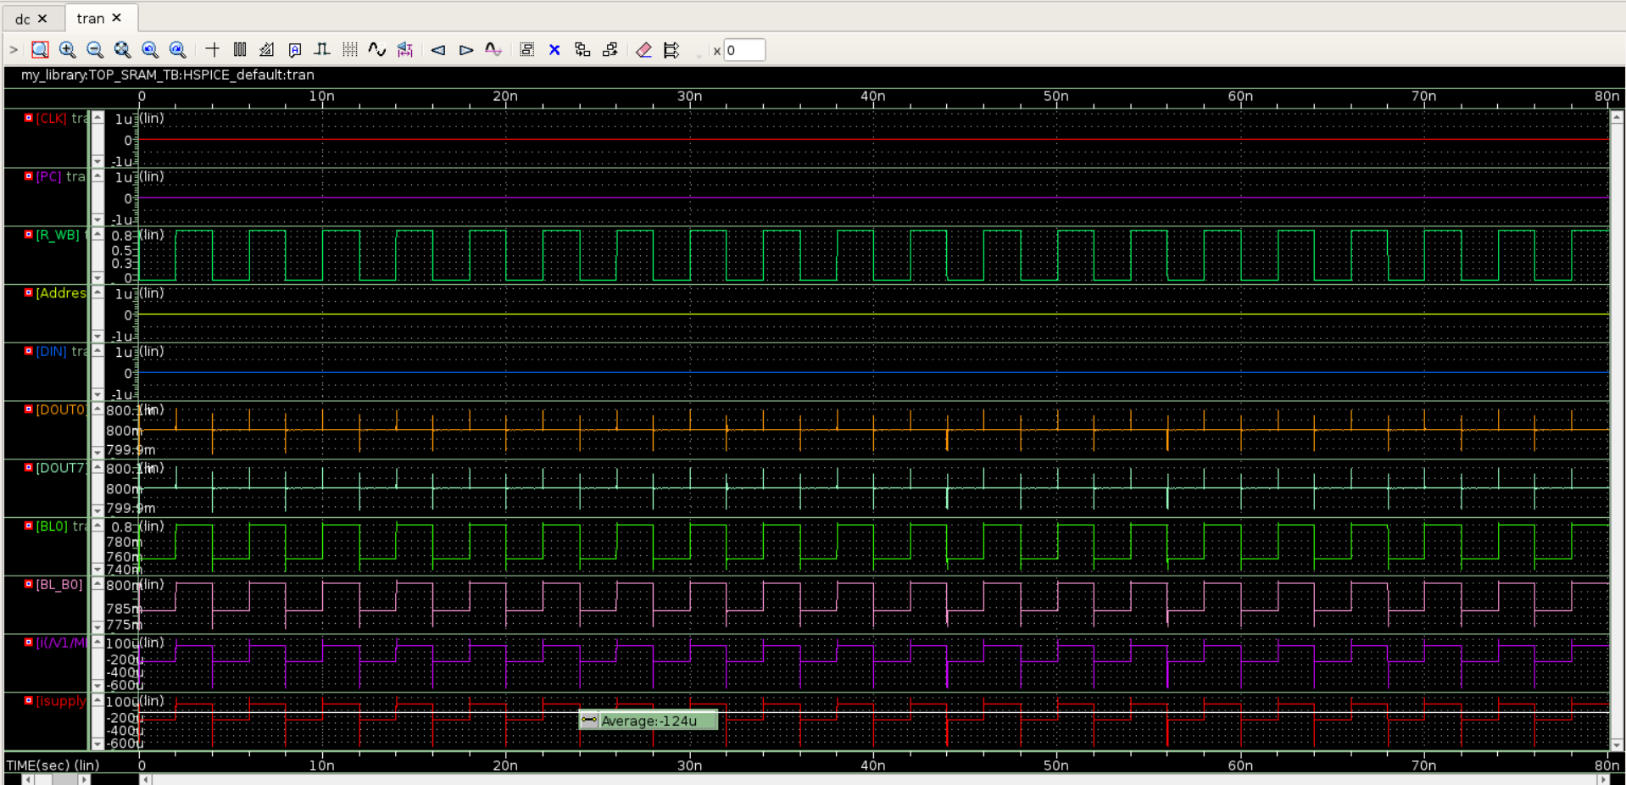
PRE-LAYOUT STANDBY POWER
Standby Power = Avg.Current x Voltage = 124 $μ$A x 0.8 V = 99.2 $μ$W

Slide 22
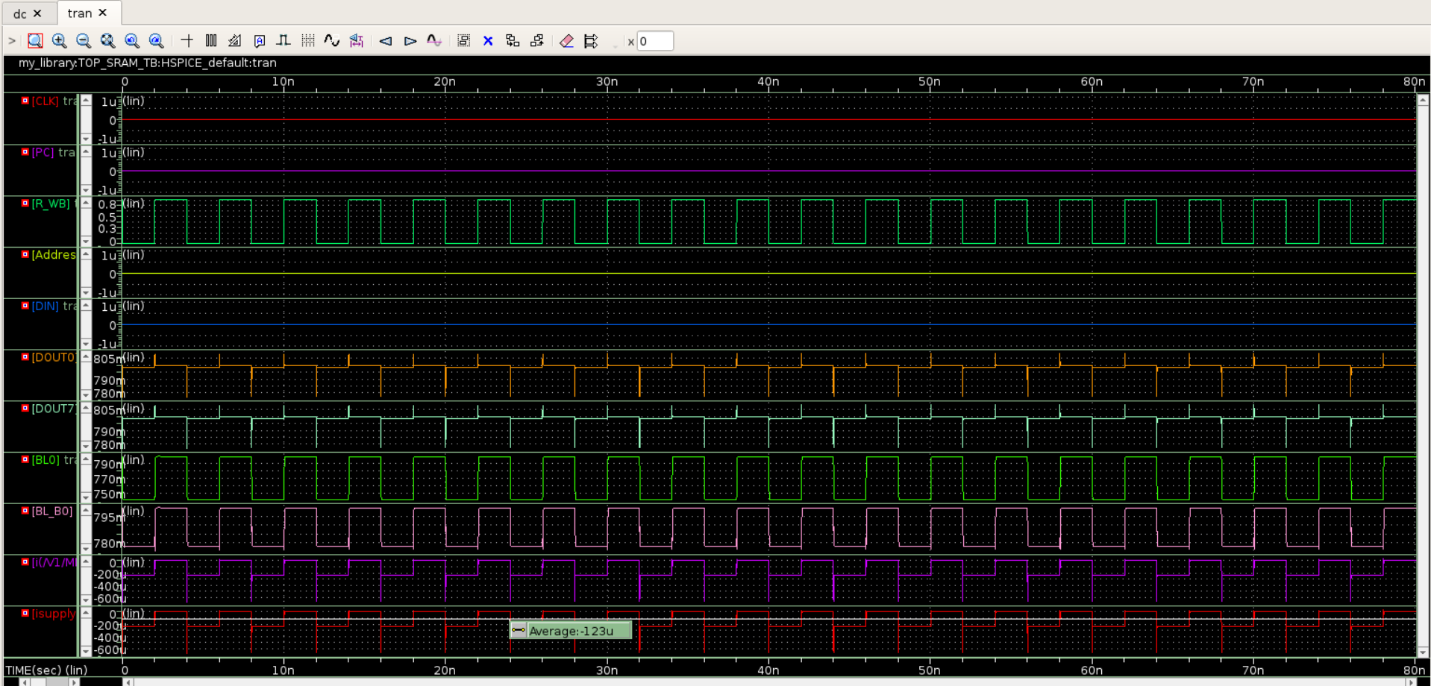
POST-LAYOUT STANDBY POWER
Standby Power = Avg.Current x Voltage = 123 $μ$A x 0.8 V = 98.4 $μ$W

Slide 23
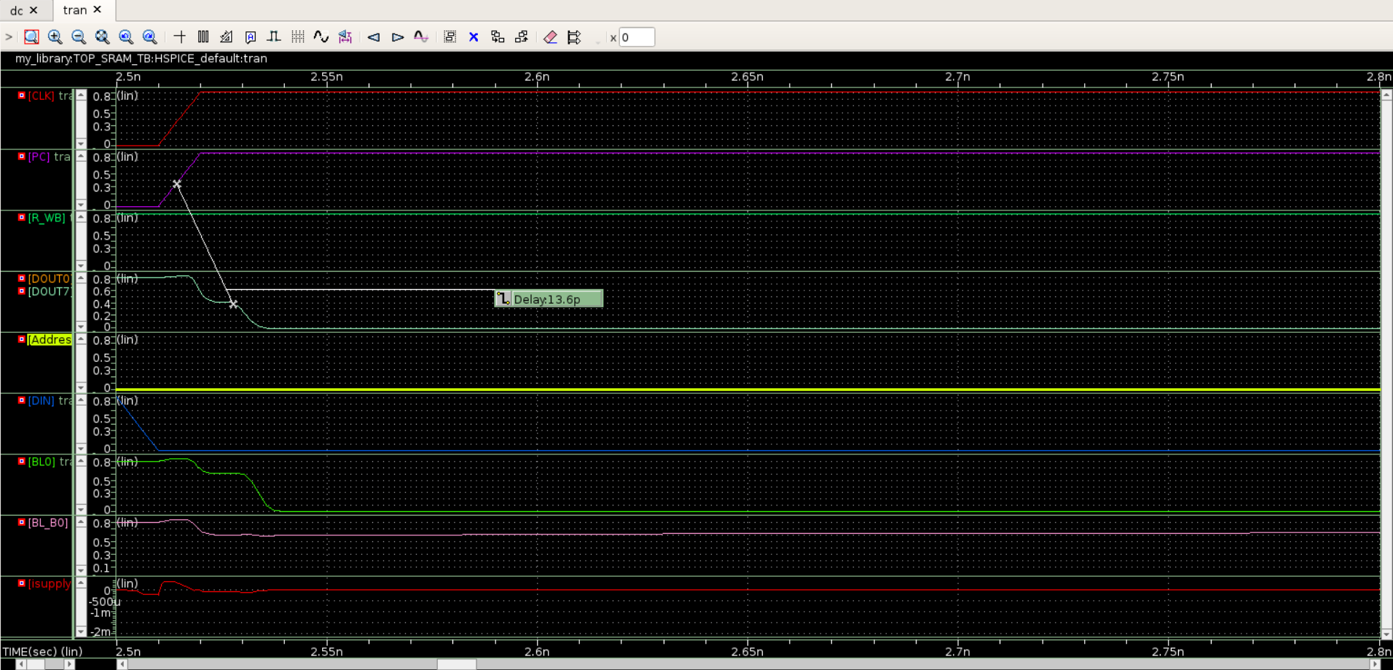
PRE-LAYOUT READ ACCESS TIME – (13.6 p)

Slide 24
POST-LAYOUT READ ACCESS TIME – (21.5p)

Slide 25
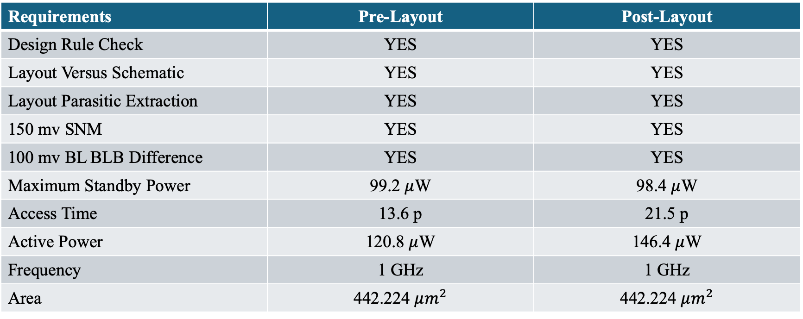
PROJECT REQUIRMENTS ACHIEVED
Requirements | Pre-Layout | Post-Layout
Design Rule Check | YES | YES
Layout Versus Schematic | YES | YES
Layout Parasitic Extraction | YES | YES
150 mv SNM | YES | YES
100 mv BL BLB Difference | YES | YES
Maximum Standby Power | 99.2 $μ$W | 98.4 $μ$W
Access Time | 13.6 p | 21.5 p
Active Power | 120.8 $μ$W | 146.4 $μ$W
Frequency | 1 GHz | 1 GHz
Area | 442.224 $μm^{2}$ | 442.224 $μm^{2}$

Slide 26

THANK YOU

